Slide 1

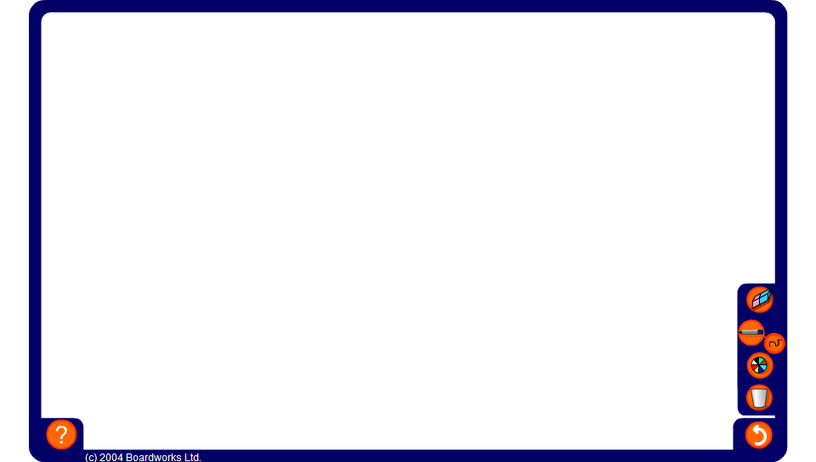

Symmetry puzzle
Notes:
Challenge pupils to fit the puzzle pieces to make a single shape with rotational symmetry. The individual pieces can be rotated and snap together to make a single shape.
Repeat the activity to make shapes with both line symmetry and rotational symmetry.

